Slide 1
Reading and Translating English Scientific Literature (ESL)

Slide 2
Definition of Scientific Literature
Types of Scientific Literature
Stylistic Features

Slide 3
What is scientific literature?
Structure of the definition sentences
term= class + (characteristics)
For examples:
A university is an institution of higher education and research which grants academic degrees in a variety of subjects and provides both undergraduate education and postgraduate education.
Wireless power is the transmission of electrical energy from a power source to an electrical load without man-made conductors.
(无线供电是无需架设传输设备实现电能从电源到用电设备的传输。）

Slide 4
What is scientific literature?
Sientific literature comprises scholarly publication that report original empirical and theoretical work in natural and social sciences, and within an academic field.
Social science includes philosophy, economics, law, education, literature, art, history, management, political science, Marxist theory, journalism and Communication, sociology, Chinese language and literature, foreign language and literature and other disciplines of all majors.
Natural science is the study of organic or inorganic things and phenomena in nature, including mathematics, astronomy, physics, chemistry, earth sciences, biology science…

Slide 5

Types of Scientific Literature

Slide 6
Sorting criterion
According to form
According to depth of processing
According to media

Slide 7
form
Journal
Monograph
Conference documents
Graduation papers
Technical reports
Science news
Patents
Product specifications
Government publications
Standards
杂志
专著
会议文件
毕业论文
技术报告
科学新闻
专利
产品规格
政府出版物
标准

Slide 8
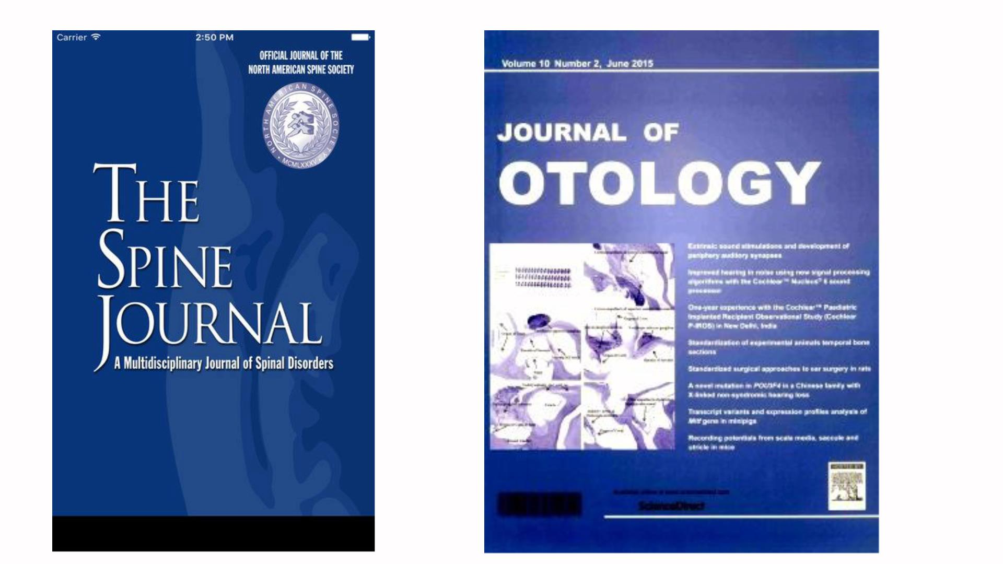
Group discussion:
Please discuss the types of the following scientific literature.

Slide 9

monograph

Slide 10
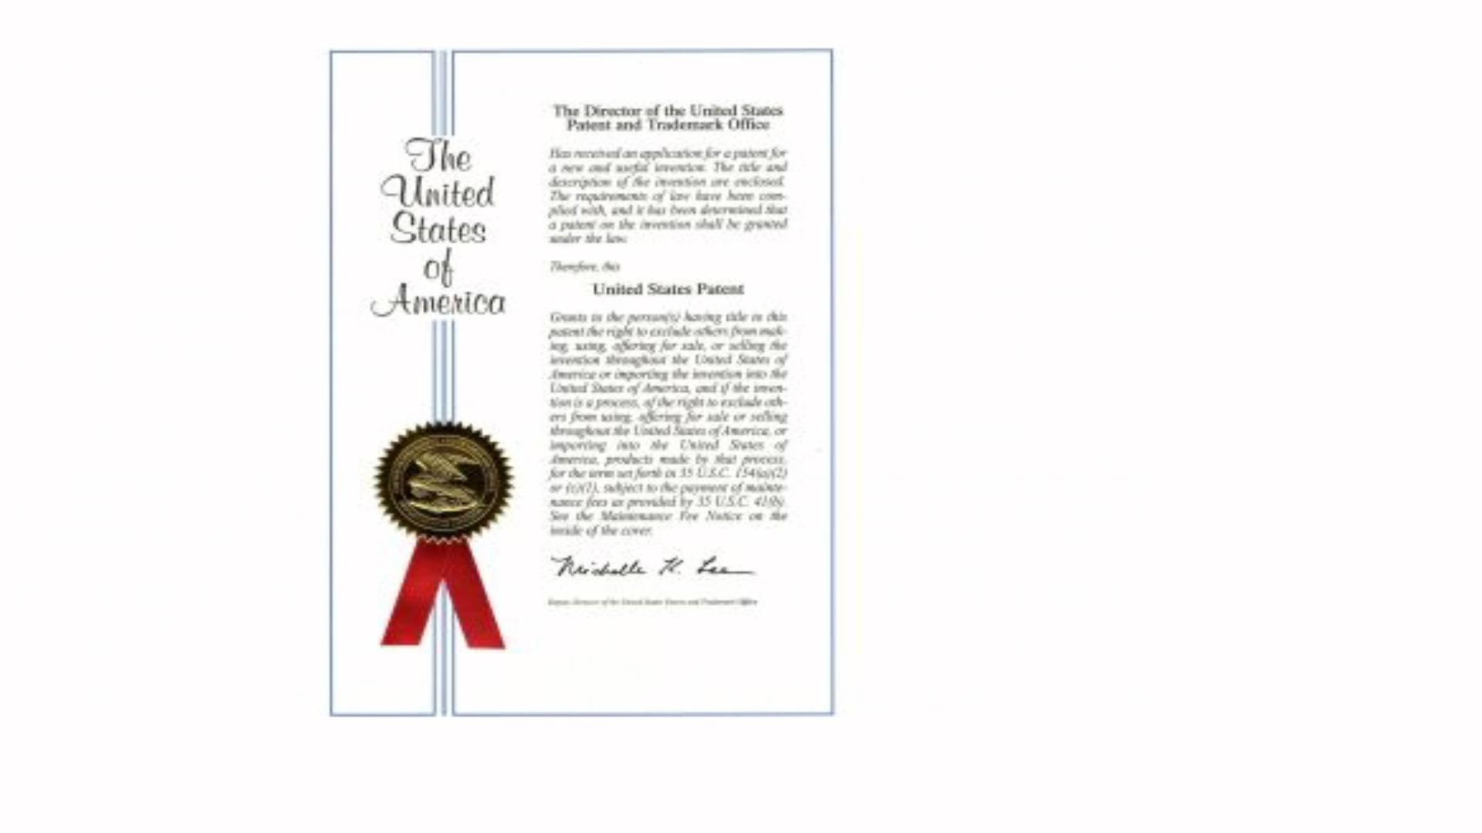
patents

Slide 11
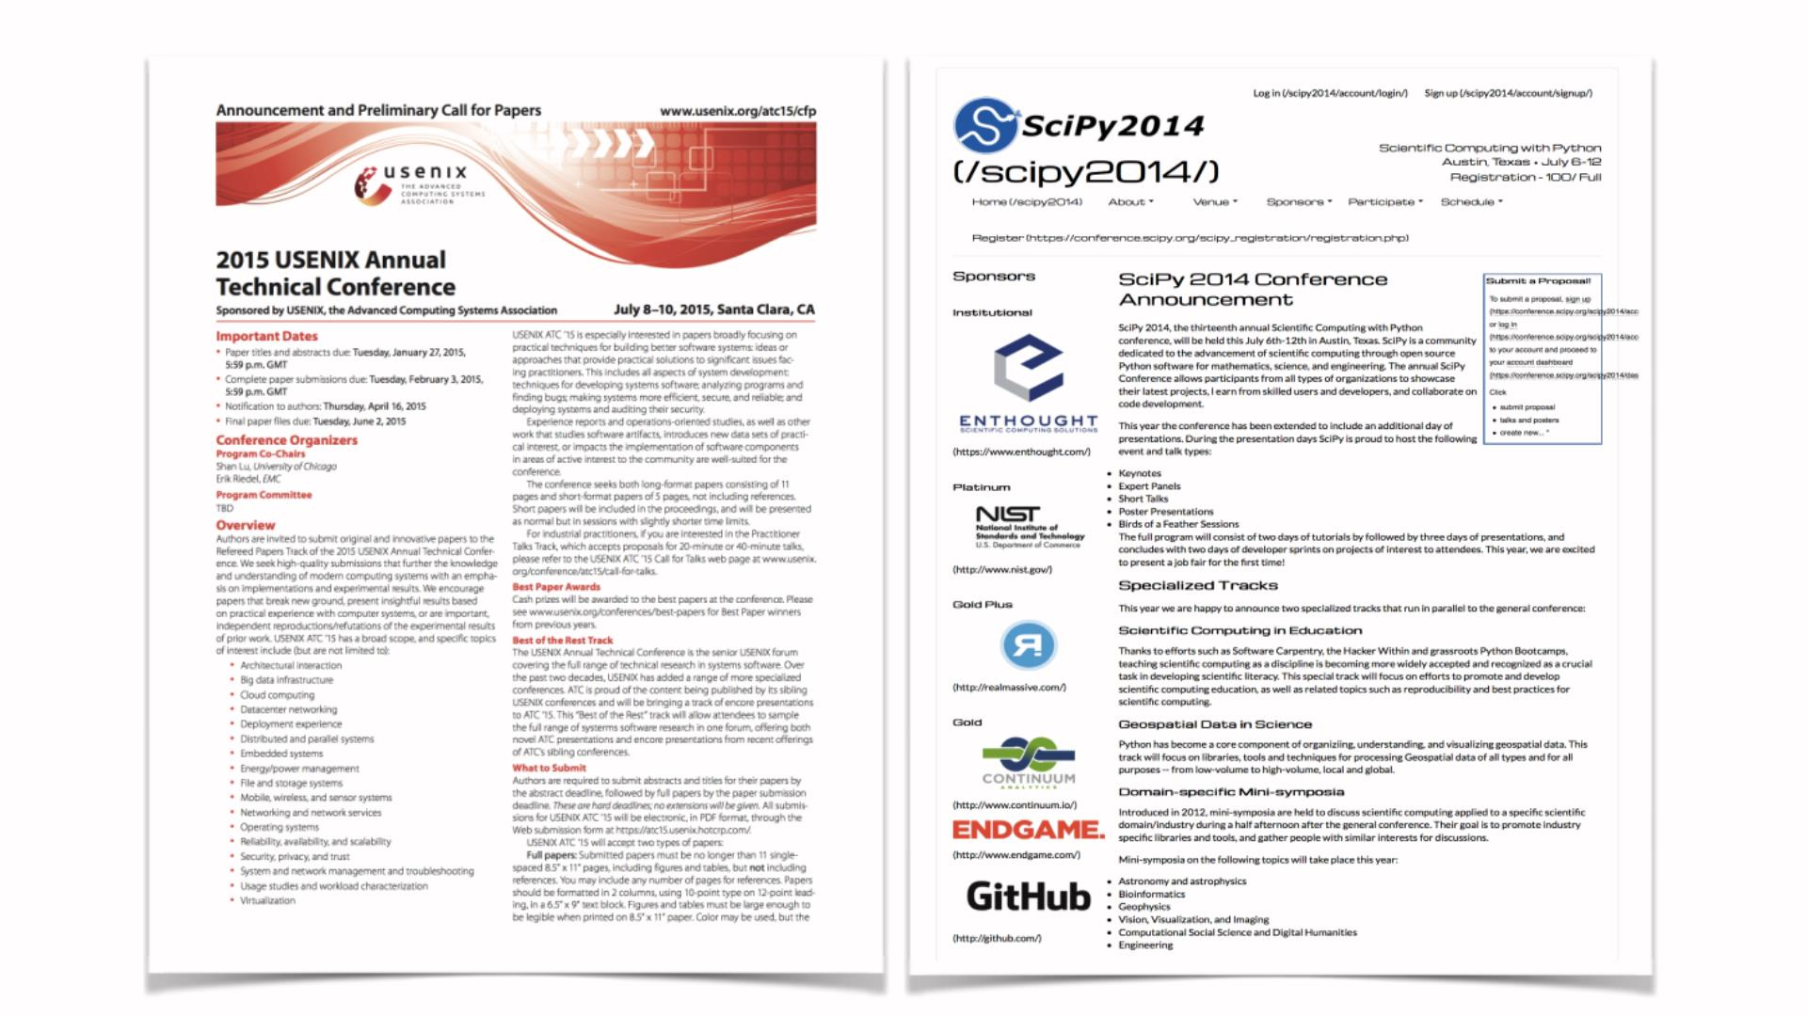
Conference documents

Slide 12
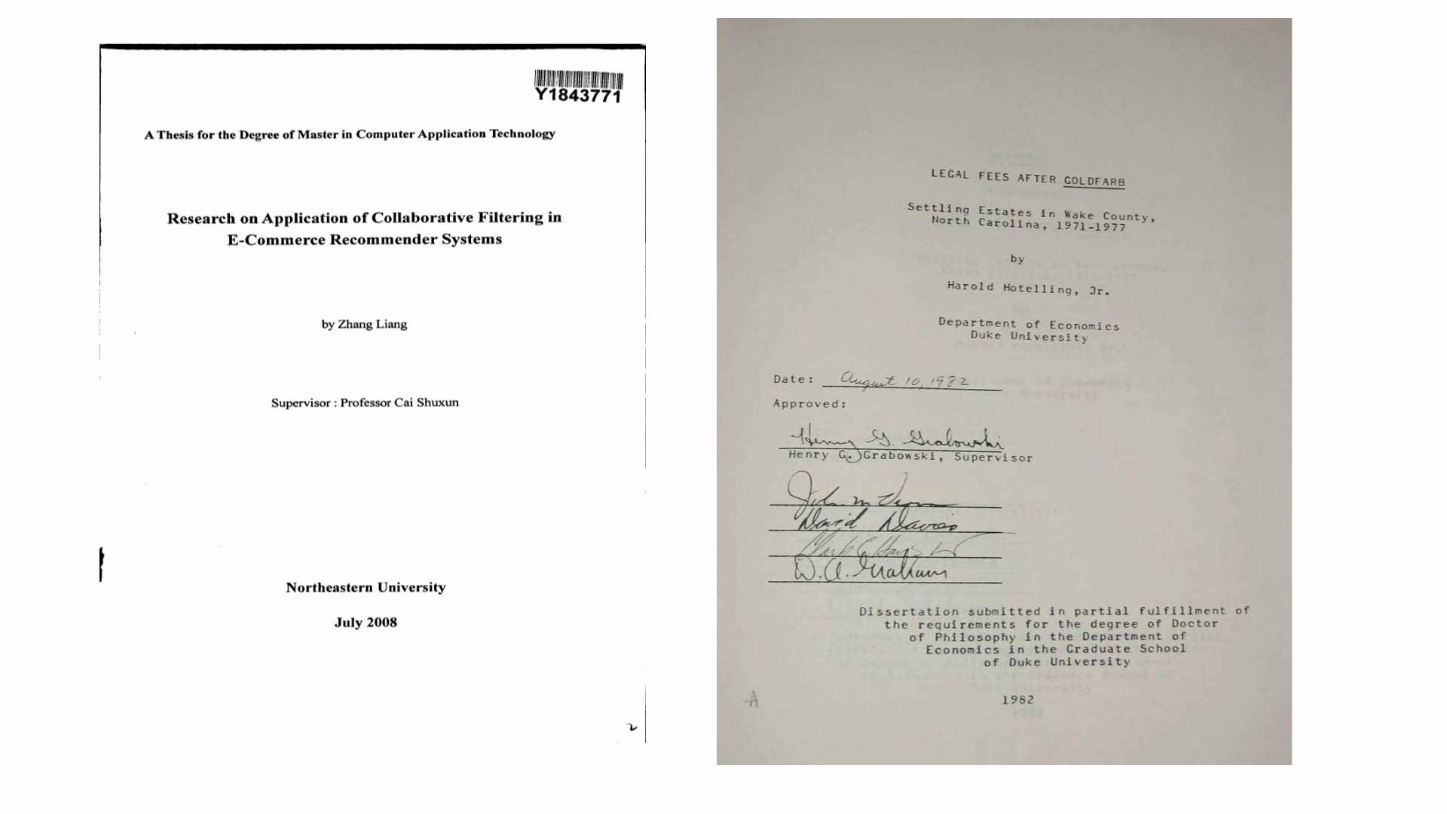
Graduation paper

Slide 13
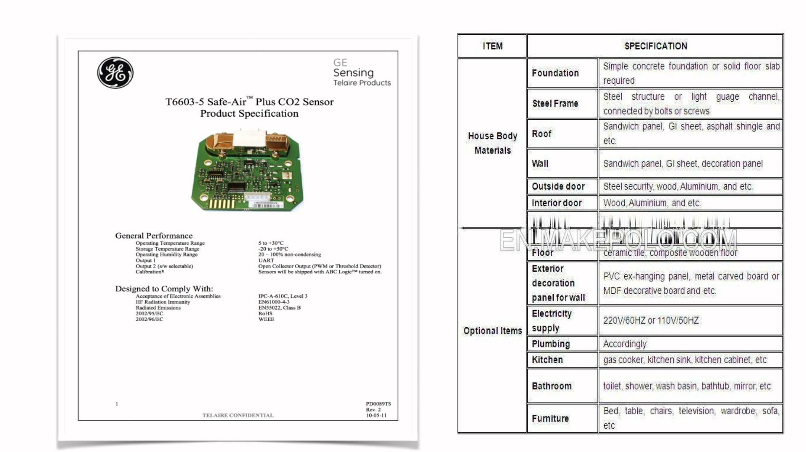
Product specification

Slide 14
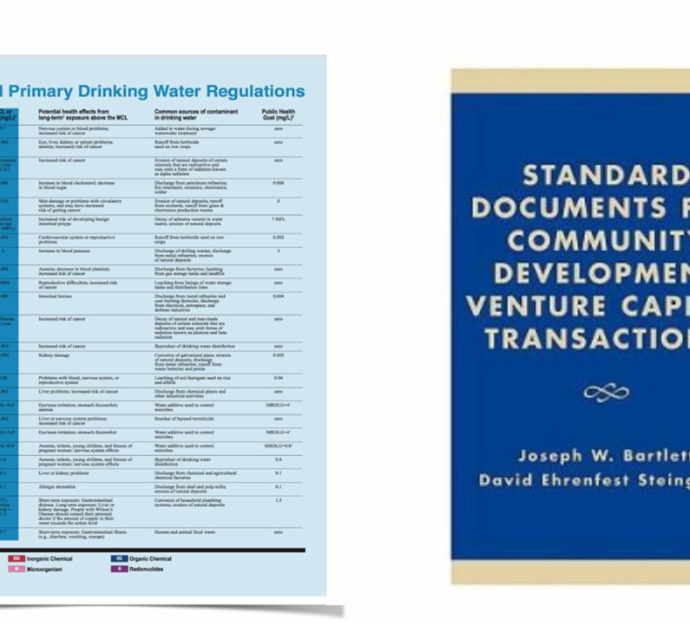
standards

Slide 15
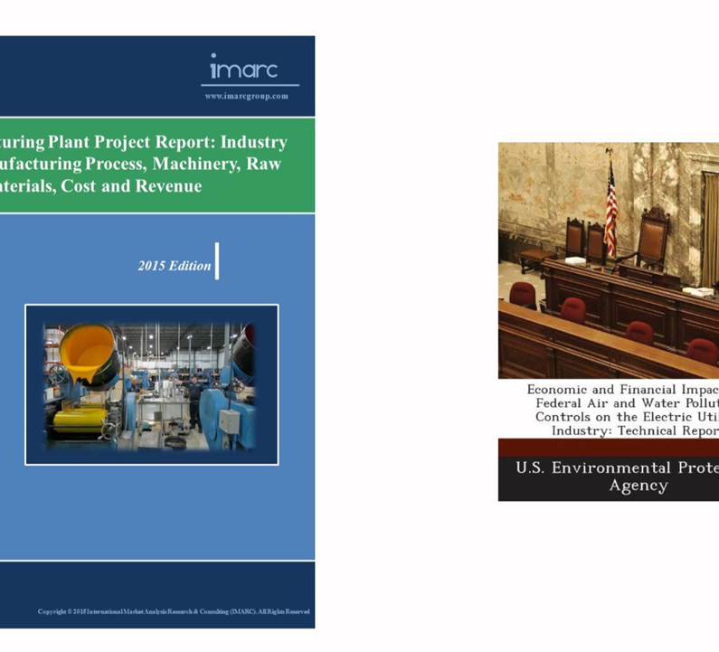
Technical report

Slide 16
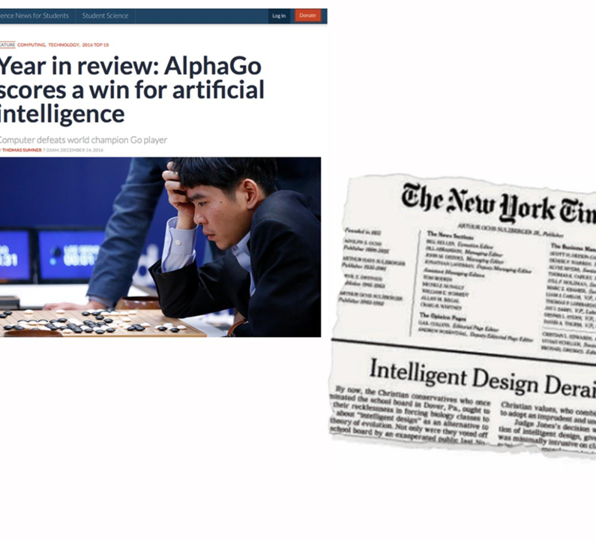
Science news

Slide 17
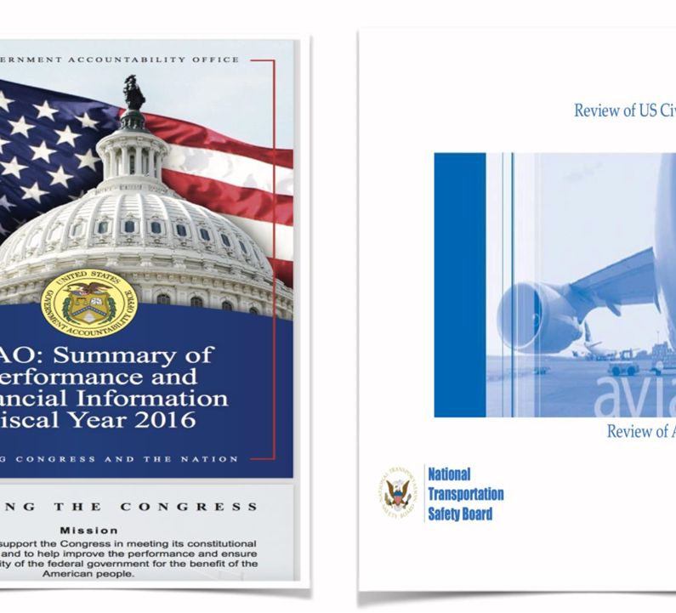
Government publication

Slide 18
depth of processing
Primary Literature(一次文献）
Secondary Literature
Tertiary Literature

Slide 19
Primary Literature includes the original scientific materials publishing for the first time, such as the research papers, technical reports, patents, conference proceedings, graduation papers. It aims
to present new scientific data or ideas
to present novel scientific research
to present perspectives or analyses literature reviews
to comment upon the immediate results of research activites

Slide 20
Secondary Literature
to summarize and synthesize the primary literature
e.g.
monograph
Review articles （综述类的文章）
Symposia (专题论文集)

Slide 21
Tertiary Literature
to consist of published works based on primary or secondary sources
in popular style
for nonscientific audience or for scientists in other disciplines
E.g. textbooks, Encyclopedias, Science magazines, Standards……

Slide 22
media
• Printing
• Microform (缩微印刷品)
• Machine-readable
• Audio-visual 视听
• Objects (non-verbal forms)

Slide 23
3. stylistic features
The COVID-19 pandemic has escalated into one of the largest crises of the 21st Century. The new SARS-CoV-2 coronavirus, responsible for COVID-19, has spread rapidly all around the world. The Spanish Government was forced to declare a nationwide lockdown in view of the rapidly spreading virus and high mortality rate in the nation. This study investigated the impact of short-term lockdown during the period from March 15th to April 12th 2020 on the atmospheric levels of CO, SO₂, PM10, O₃ and NO₂ over 11 representative Spanish cities. The possible influence of several meteorological factors (temperature, precipitation, wind, sunlight hours, minimum and maximum pressure) on the pollutants’ levels were also considered. The results obtained show that the 4-week lockdown had significant impact on reducing the atmospheric levels of NO₂ in all cities except for the small city of Santander as well as CO, SO₂, and PM10 in some cities, but resulted in increase of O₃ level.

Slide 24
Sample 2:
In this study, Mabs were produced against FMDV O/JPN/2000, A15 TAI (1/60), and Asia 1 Shamir (ISR3/89), and MSD-ELISAs were developed. (2) The problem of FMDV anti-genic diversity was resolved by using Mabs (1H5 and 71F2) that were able to detect multiple serotypes of FMDV. (3)Further-more, the specificities and sensitivities of the MSD-ELISAs were improved by using serotype-specific Mabs (70C4, 16C6, and 7C2) as antigen-detecting antibodies.

Slide 25


